Slide 1
EDA - Gramener Case Study
Group Name:
1. Balakrishna Gadiyar
2. Bishnu Agrawal
3. Deepak Kumar Padhan

Slide 2
Abstract :
A lending companies, lending loans to ‘risky’ applicants is the largest source of financial loss (called credit loss). The credit loss is the amount of money lost by the lender when the borrower refuses to pay or runs away with the money owed. The default borrowers cause the largest amount of loss to the lenders are labelled as 'charged-off' are the 'defaulters'.
Business Objectives :
The Objective of analysis is to ,
Identify the risky loan applicants to avoid credit loss.
Highlights the driving factors (or driver variables) behind loan default.

Slide 3
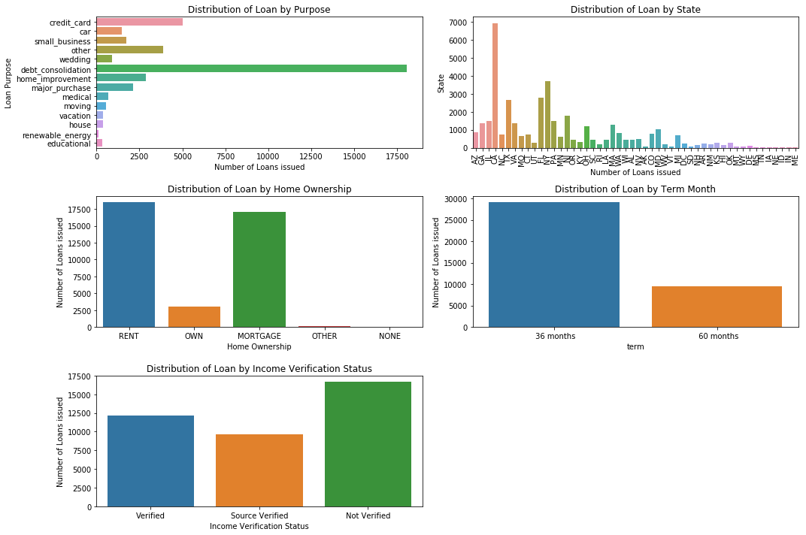
Univariate Analysis- Unordered Category

Slide 4
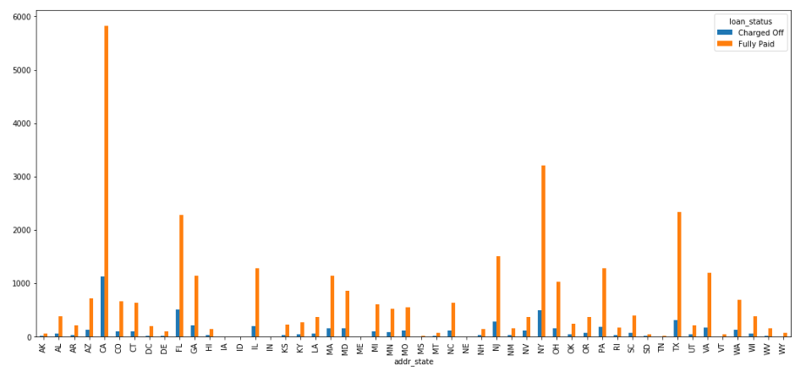
Univariate Analysis- Unordered Category

Slide 5
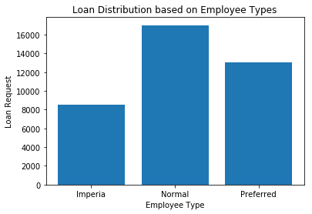
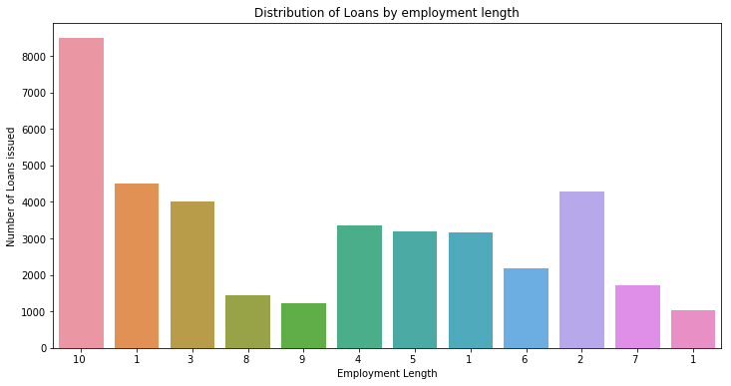
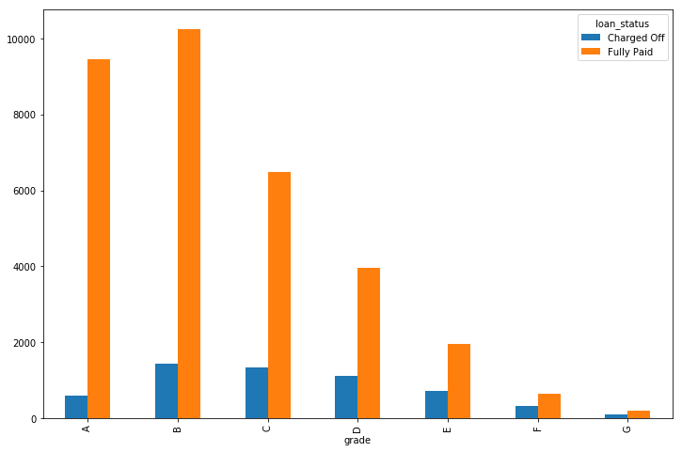
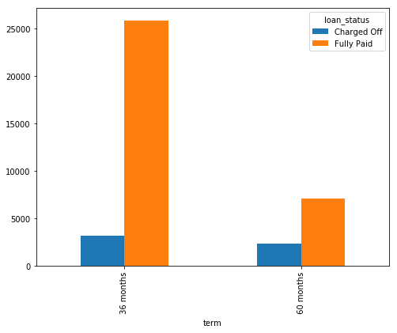
Univariate Analysis- Ordered Category

Slide 6
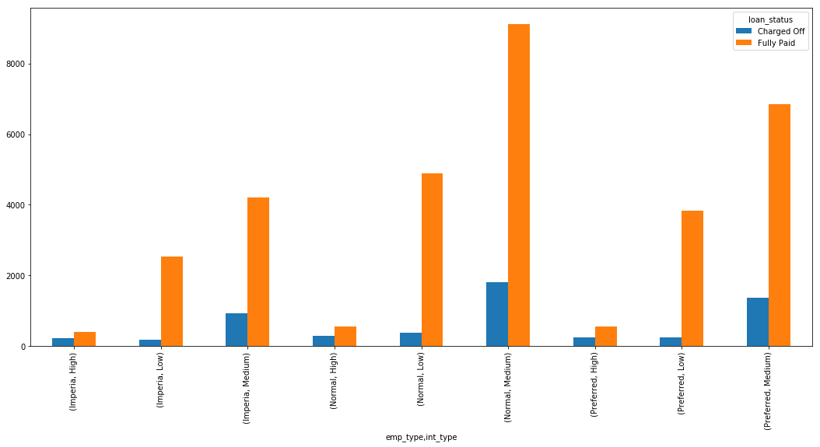
Bivariate Analysis – Employee Type & Interest Type

Slide 7
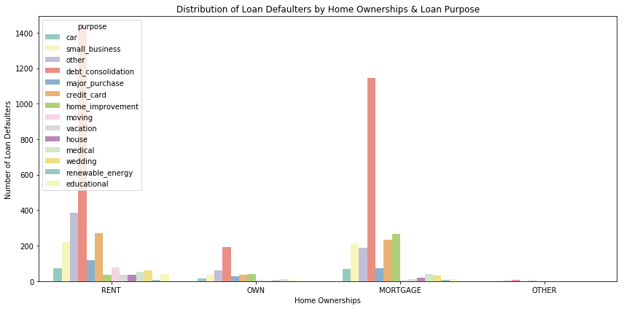
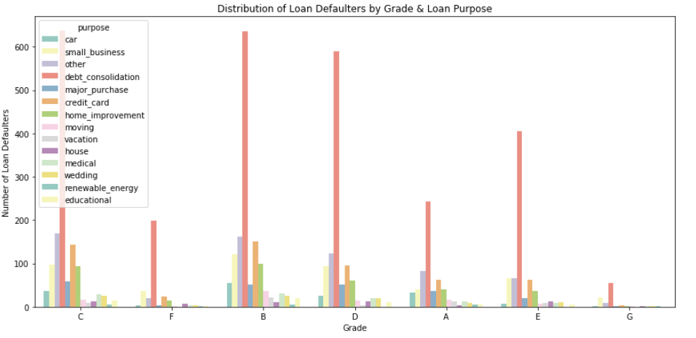
Bivariate Analysis

Slide 8
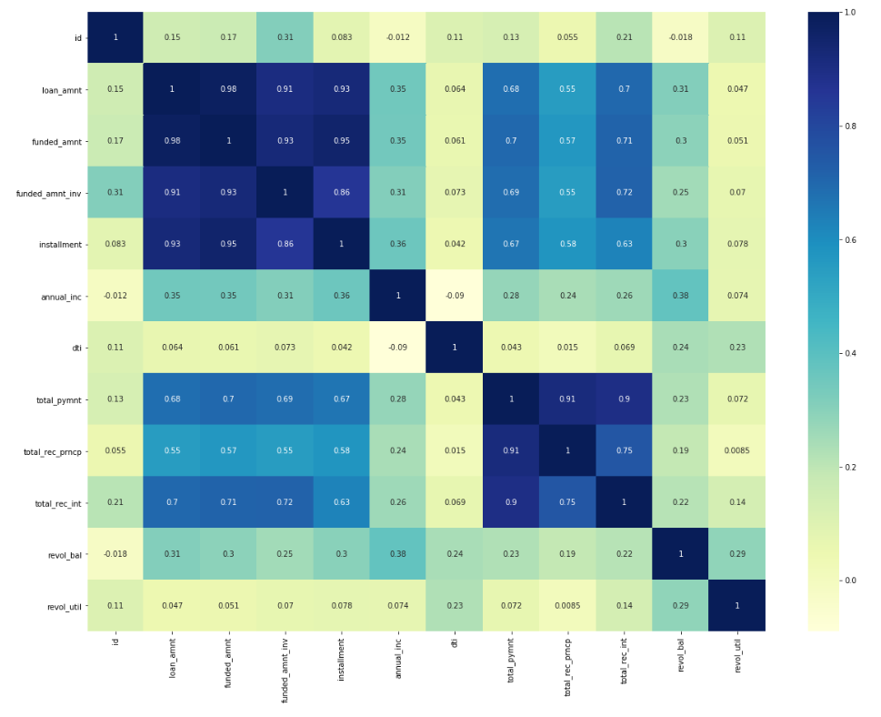
Quantitative Multivariate Analysis

Slide 9
Conclusions :
Here is the conclusions we draw from these hypothesis :
Unverified loans are going to defaults
Short term rates have high chances of going to default
Customers from CA,FL,NY,TX and NJ are highest probability of being in defaulter's list
Debt consolidation type of loans are mostly in being defaulted
Normal customers (<4 years) taking short term loans with interest rates ranging between 10-18% are higher probability of being charged off compare to long term loans
B, C and D graded loans have higher probability of being charged off
Rented and mortgage type of ownership has higher probability of going into defaults.

